Slide 1
RMBL R Workshop 1
Module 0: Introduction to R Studio
Module 1: Importing Data and Basic Data Manipulation
Module 2: Displaying and Summarizing Data
Module 3: Hypothesis Testing
Module 4: Examples of Four Hypothesis Tests
Notes:
Welcome to the first workshop of two workshops covering how to use R for your statistical computation. While we only have two total hours with you over these two workshops, we hope that you will gain a better understanding of how to use R to understand the data you are collecting over this summer. We will start out with a quick orientation to R studio and then we will all import sample data from an Excel file. Next, we will focus on the basic commands for displaying and summarizing data (based on what type of data you collected). Afterwards, we will get to the heart of this workshop which is to allow you to test the hypotheses that you asked a few weeks ago, and finally, we run through a few examples of hypothesis testing together. I will start us out while Vinko will guide us through the four example tests.

Slide 2
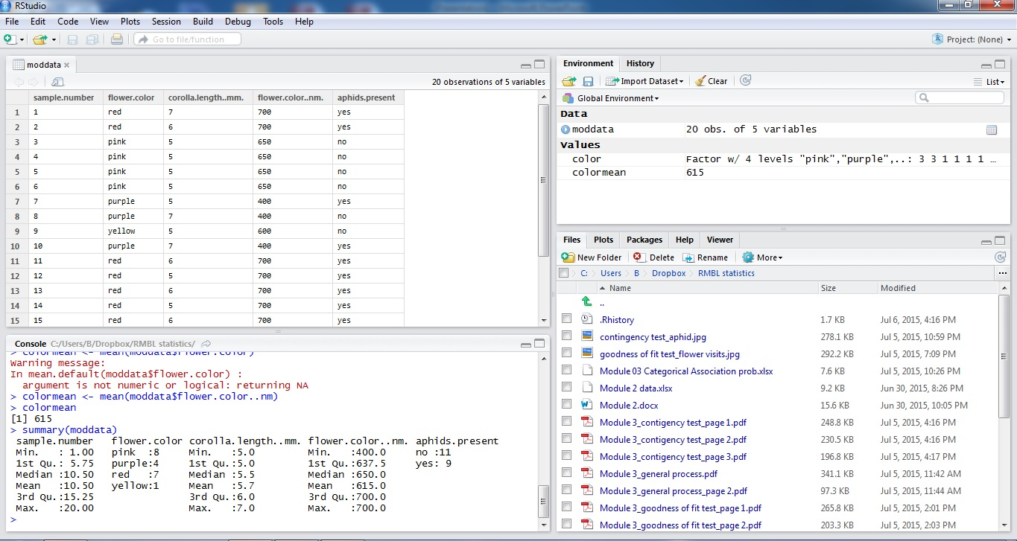
Module 0: Intro to R Studio
Notes:
I would like you all to open up R Studio so you can begin to orient yourself to the program. It will probably look pretty familiar in some aspects and very different in other aspects. R studio is a user-friendly interface for R that is free! It allows you to easily focus on your data analyses in a user-friendly format.
If you notice, there is a toolbar at the top that has some commands conveniently located in a top-down window. You can save files, open files, and save plots much like you would in any other software package like JMP.
Let’s start in the right hand corner of the page. This area is like the memory for R studio. It stores not only the variable and their values that you assign to it but also your command history. The environment tab lists what data you have uploaded and gives the values for variables you have assigned during your computations. The history tab gives a list of all the commands you have used in the console. You can click on commands in the history tab and copy them to the console in case you need to repeat a computation.
The bottom right hand corner displays the files in your working directory, plots you may have created, and packages you may have downloaded. The files tab allows you to search through your computer for a file you may need to work on. It does not allow you to upload the data directly into R studio. You have to import the data following the procedure we will outline shortly. The plots tab will display the plots that you will generate as you trying to understand your data. The packages tab shows all the packages you have downloaded. Packages are collections of functions, data, and other code that allow you to complete a set of tasks. There are some packages that come with R Studio, and there are others that you need to install as you use R for more statistical applications. For example, if you were interested in using R for phylogenetic analyses, you might want to install picante, a package that allows you to assess phylogenetic community structure, or the relatedness of the different species found in your study communities. Packages are free, and they were developed by members of the open source R community for everyone’s use.
The bottom left-hand corner is your console, or where you will enter R functions to allow you to statistically compute in real-time. If accidentally mistype an error, R will spit out an error message that should be fairly informative. Depending on the error message, you should be able to quickly figure out what you did wrong. You do have the option of creating scripts, or R files, that allow you to run a series of functions as one. You can save all your statistical steps as a script for your future reference. We will not save any scripts at this moment because we want to focus on learning the functions. We want you to see the output immediately so you learn how each function works.
And finally in the top left corner is your data! You don’t have this corner yet since you haven’t imported any data. So let’s start importing!

Slide 3
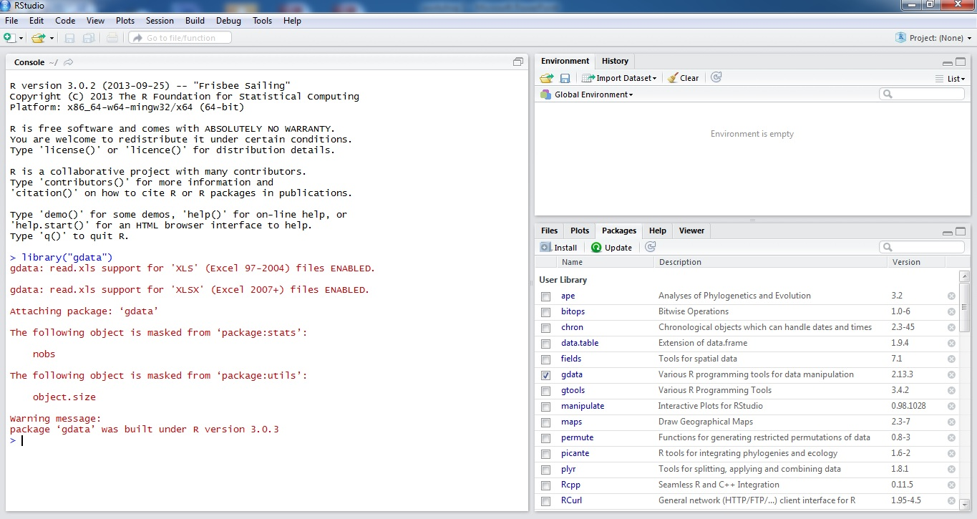
Module 1: Importing Data
Notes:
Vinko has conveniently downloaded the Module 2 data to the Documents folder of your computer. Please search for this folder on your computer through the files tab in R studio. We will now set the working directory in R, or the place from which you will read data from and write R computations to. You can set the working directory via two ways:
You can go to the toolbar at the top. Click on Sessions tab. Scroll down to the “Set working directory” tab, and then click on the “Files Pane Directory”. You will notice that a command setwd(directory location) will pop-up. That’s the R command that you could type to set the working directory.
setwd() is the other way to set the working directory.
It’s important to set the working directory for each R session so you can keep track of your computations. This will allow you to organize your data analyses in one place and make it easy for R to access the data you need.
Now that we have set the working directory to where your data is located. Let’s import some data. You’re conveniently working at a computer at which someone probably has done a lot of R computations. So you might already have the package available to you. Open the packages tab in the bottom right hand corner. Look for the package gdata or xlsx. Both packages will allow you to import data from Excel. This workshop exclusively focuses on importing data from Excel since most biologists enter their data into Excel. gdata uses Perl to import Excel files into R while xlsx uses Java to import Excel files.
If you don’t have gdata or xlsx, you can quickly add either package by using the command: install.package(“xlsx”)
This will download the package for you.
Now that you have confirmed that you have the gdata or xlsx packages, let’s load them into your active R session. While the package exists in your R library, you need to load the package with its code into your active R session so the R compiler can easily access it. You will do this by using
library(“xlsx”)
Alternatively, you can just check the box next to the package which loads the library command into your console. This loads the package into your active R environment.

Slide 4
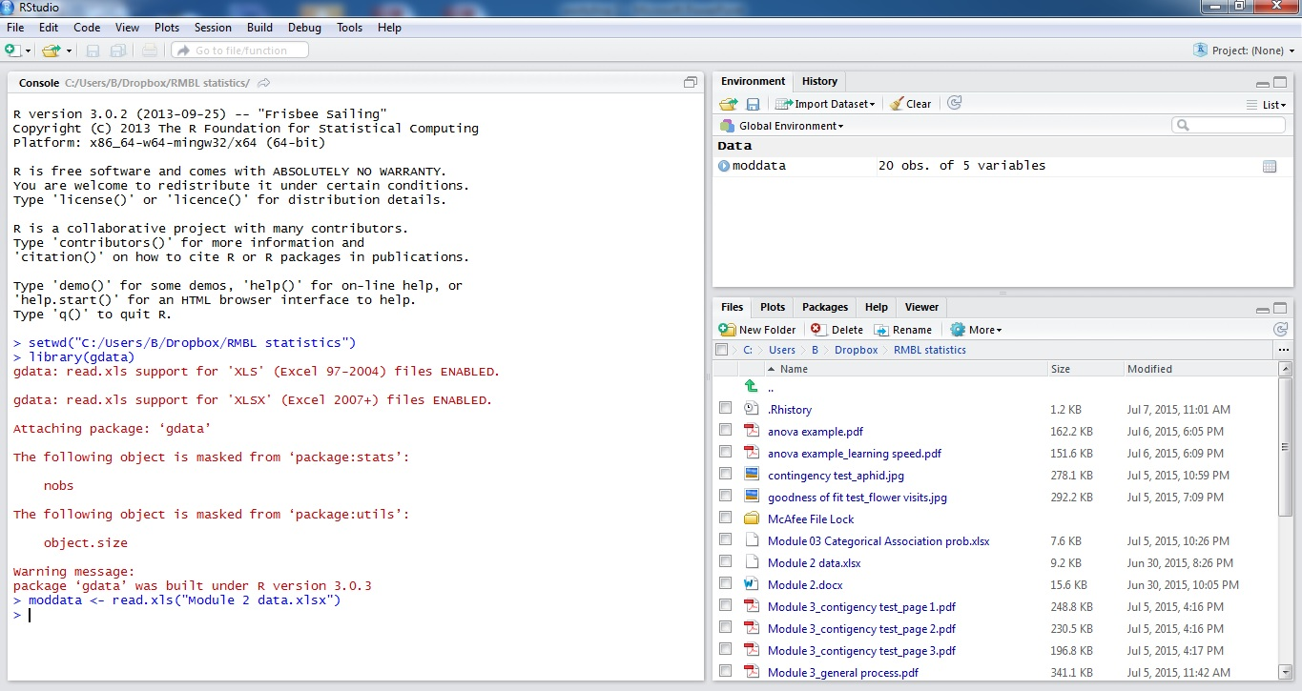
Module 1: Importing Data
moddata <- read.xls(“Module 2 data.xlsx”)
variable
assignment symbol
Notes:
Now that you have loaded either xlsx or gdata into your active R environment. You’re ready to import the Module 2 data file. To make it easy to work with the data once it’s been loaded, let’s give it a name. We will assign this name to the data set so we can easily call it up in functions.
Let’s call the Module 2 data set…moddata. We will assign the imported Excel file to moddata using the <- assignment symbol. (You can use the = symbol to make assignments in R. But it’s just convention that you use <-.)
So enter:
moddata <- read.xls(“Module 2 data.xlsx”)
If you click on moddata in your environment window or type in View(moddata) , you will be able to view your data.

Slide 5
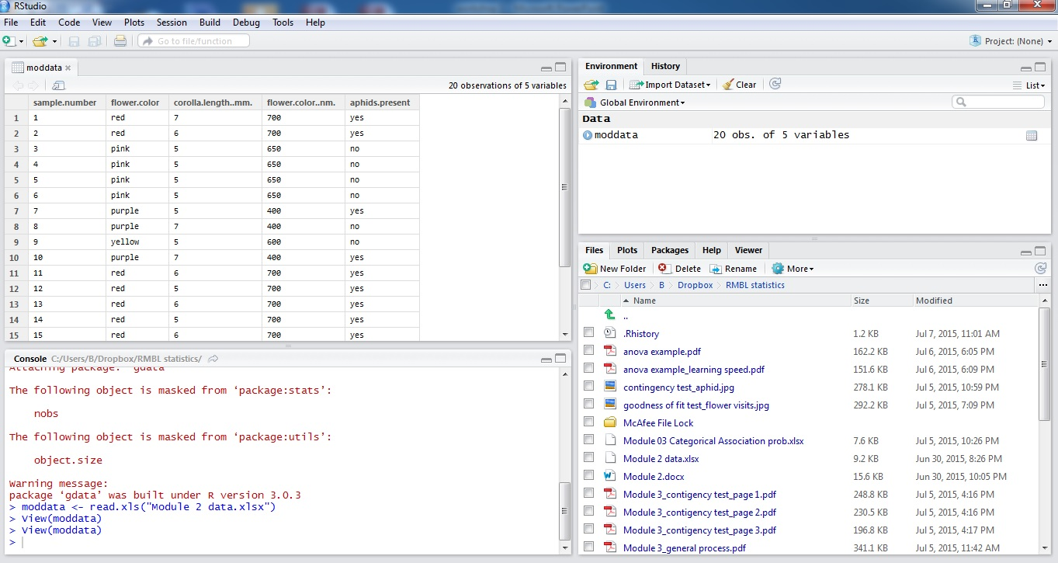
Module 1: Importing Data
Notes:
You can’t edit the data directly in this data window. But it can be handy to have in front of you as you think through your data analyses as you call up certain columns. You’ll remember what you called them this way.

Slide 6
Module 1: Manipulating Data
Data type | Example
numeric | 3.4
Integer | 3 | as.integer()
complex | 2+ 3i
logical | TRUE, FALSE | x <- 4, y<- 3 z <- x >y
character | a, b, 4, 5.6 | as.character()
Notes:
We’re going to quickly cover how R views your data since it may come in handy as you progress through your statistical computations. Many of these constructs are already very familiar to you from your math classes in part because R is a very mathematical language.
R has five basic data types: numeric, integer, complex, logical, and character. These may be very familiar to you. Numeric is just numbers (i.e. with a decimal), integers are integers and you can make a data type an integer with as.integer. R will usually read your data in as numeric unless you set the data to be read as integers. Complex are the complex numbers you came across in high school. Logicals are true, false statements. They are actually TRUE AND FALSE, but also variables that lead to a TRUE/FALSE result. And characters are the familiar text type which you can make with as.character(). Numbers can be made into characters with as.character()
While this may seem a bit trivial, it’s important for when you start using functions. You need to make sure you are using the correct data type as inputs for R functions. And this is where knowing the data types comes in handy.
Now let’s move onto the next higher organization of data.

Slide 7
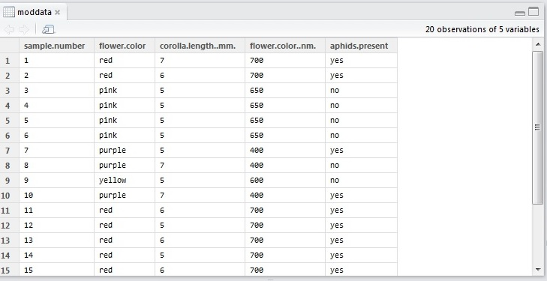
Module 1: Manipulating Data
All of these are vectors.
To call up the sample number: samplenumber <-moddata$sample.number
Notes:
R will view your data in a few ways. Typically, columns in your data set are vectors or strings of data of the same type. For example, corolla.length only includes corolla length measurements, and they are all of the same data type, presumably because you measure the corolla length, or opening of a flower, in the same manner. Likewise, aphids.present is another vector of character data with yes or no, presumably again because you characterized the presence of aphids with a yes or no.
You can call up a column or vector of your data with the $ command. To call up sample.number, you can use
sample.number<- moddata$sample.number

Slide 8
Module 1: Manipulating Data
assigned variable
concatenate function
> vectorexample <- c(1, 2, 3, 4, 5)
> vectorexample
> [1] 1 2 3 4 5
informs you that this is a one-dimensional data type, or essentially a string of numbers
Notes:
If you want to make a vector, you can using the concatenate command. Here we made an new variable called vectorexample. We did this to allow us to call this vector into different functions easily. When we call vectorexample, R tells us that this is a one-dimensional data type or just a string of numbers.

Slide 9
Module 1: Manipulating Data
concatenate function again
> matrixex <- matrix(c(1, 2, 3, 4, 5, 6), nrow=2, ncol=3, byrow=TRUE)
> matrixex
> [,1] [,2] [,3]
[1] 1 2 3
[2] 4 5 6
tells you how you want to fill the matrix
Notes:
I’m going to introduce one last data type, the matrix. A matrix is simply a two-dimensional set of data with rows and columns. We can make a matrix with the matrix function. Here we take a vector string (which we make with the concatenate function) and then designate how many rows and columns we want along with how we want R to fill the matrix…by row
When we call up our example matrix, R shows us how it laid out the matrix.
Your data will be viewed by R as a series of vectors and matrices, and while it’s important to know that. It’s also handy sometimes to be able to enter the vector or matrix directly especially if it’s a short string (it’s quicker than importing). You might find the matrix function handy when we start running contingency analyses or trying to find associations between two categorical variables.
While there are a few more R data organizational types and R commands to learn as far as manipulating data, we will learn them as we go. That way you can directly use them when they are the most applicable to the analyses you will run.
Now that you’re up and running in R, let’s start working with your data. For Module 2, we’re going to just focus on one screen, the projector screen. We want you to really focus on how you translate your statistical thoughts into R computations. While R is a programming language, it’s power for you comes in its built-in functions to compute the statistics required for you to understand your data. We will go through the basic functions for displaying and summarizing data followed by the four most common ways to test the hypotheses that you generated a few weeks ago. Then we will work as groups of two on the RMBL computers to practice these functions on previously-published datasets. Again, we will emphasize how you translate statistical thinking into R computation. So let’s get started.

Slide 10
Module 2: Displaying Data
Flower color
Categorical
Numerical
700 nm
680 nm
400 nm
680 nm
630 nm
400 nm
Notes:
Before we start displaying data, we need to remind ourselves what kind of data we have. There are two kinds of data: categorical and numerical. And depending on how you set up your project, you collected either type or both. Categorical data is essentially counted data that falls into categories. The data can only fall into categories. Numerical data is a quantitative measurement or essentially something that you measure with an instrument.
Let’s say you observed flower color from a particular species of flower. You could have grouped them into categories: red, pink, orange, purple. OR you could have used a spectrophotometer to measure the wavelength associated with each flower color which gives you numerical data (or data that can take on any value).
Knowing this difference is important because it will determine how you display and summarize your data. This difference will ultimately dictate how you test hypotheses concerning your data.

Slide 11
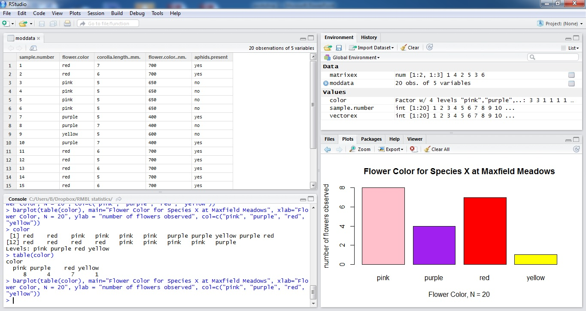
Module 2: Displaying Data
Notes:
Let’s start out with categorical data. You went out and measure flower color for twenty flowers of a particular species. You decided to categorize the colors as the standard colors we know: red, purple, orange, pink. We want to visually get a sense of what we collected, so we’ll use R to produce the familiar barplot.
First we’ll identify which column we want to display. In this case, I want to display flower color. So I assign the data column a variable, “color”, following the procedure we outlined before.
color -> moddata$flower.color
Then we need to compile this data into a counted form so we can use barplot. To do this, we use table with our color vector inside. Table will tabulate the values for each flower color, and give us a matrix that barplot can use to create the plot itself. Of course, we need to add a title, labels for the x and y axes, and we can color each bar. (Although for publications, you shouldn’t color your bars. Realistically, your publication may be printed in black and white and it would be hard to differentiate colors.)

Slide 12
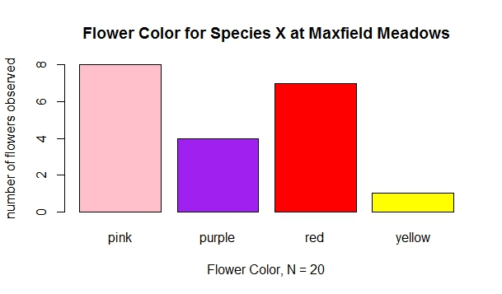
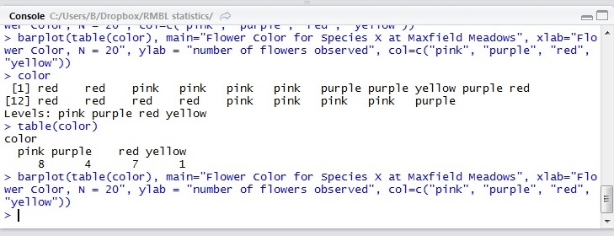
Module 2: Displaying Data
Notes:
First we’ll identify which column we want to display. In this case, I want to display flower color. So I assign the data column a variable, “color”, following the procedure we outlined before.
color -> moddata$flower.color
Then we need to compile this data into a counted form so we can use barplot. To do this, we use table with our color vector inside. Table will tabulate the values for each flower color, and give us a matrix that barplot can use to create the plot itself. Of course, we need to add a title, labels for the x and y axes, and we can color each bar. (Although for publications, you shouldn’t color your bars. Realistically, your publication may be printed in black and white and it would be hard to differentiate colors.) All this we stated in our command statement for the barplot. If you wanted to add a legend, you can! I will refer you to the barplot command documentation provided by the R development community which allows you to add more to your plots.

Slide 13
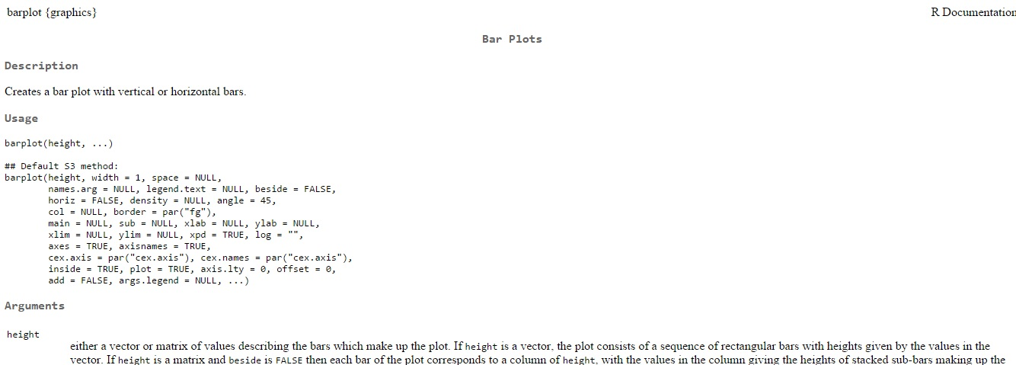
Module 2: Displaying Data
You can set the limits for the x and y axes, along with a legend (args.legend) .

Slide 14
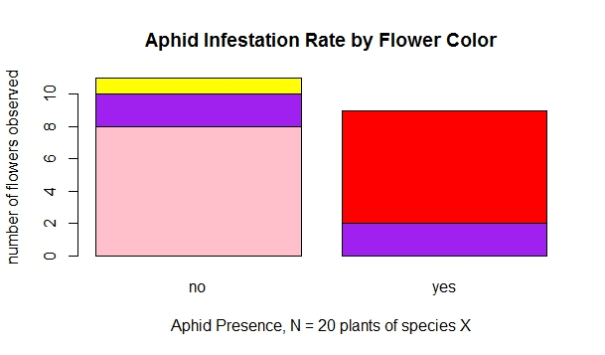
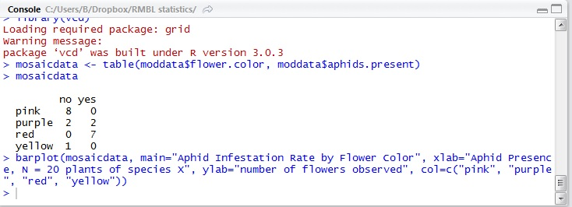
Module 2: Displaying Data
Notes:
While looking at one variable is nice, you are probably measuring more than one variable. And you probably want to look at the general association between two categorical variables. Let’s check out the potential association between flower color and whether species X has aphids on it. We can do this one of two ways: with a mosaic plot or a grouped bar plot. I will present the mosaic plot. We have the command for a grouped bar plot on the website and on your R cheat sheet. A mosaic plot is generally more compact and more commonly found in the literature which is why I’m presenting it here. A mosaic plot is like having a visual contingency table in many ways which is another reason why we’re going through it at the moment.
To make a mosaic plot, we first need to make a table of the data we want to associate.
mosaicdata <- table…matrix of values.
Then barplot with the matrix for data, and the same commands for title, x and y labels and to specify color
If you notice, red flowers tend to have lots of aphids (don’t assume this in reality)
But what if you measured flower color with a spectrophotometer? You will plot your data with a histogram.

Slide 15
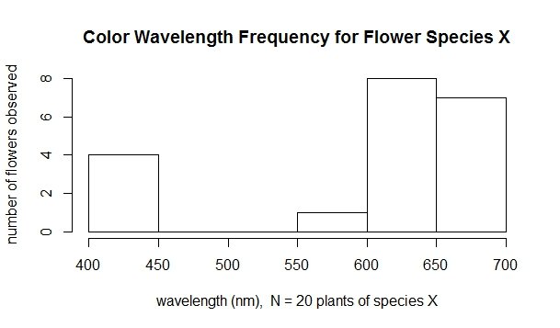
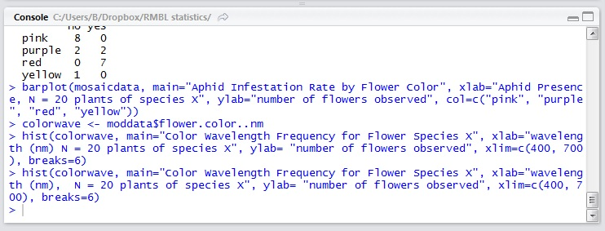
Module 2: Displaying Data
Notes:
Again, we have to extract our data of interest. In this case, we create the variable, colorwave, and we will store our data from moddata (our original data) into colorwave. Then we will use the histogram function which is very similar in syntax to barplot. Note that you first input the data, then the histogram name, then the x-axis label, y-axis label. In this case I added the range for the x-axis with xlim. I did this because spectrophotometers measure best in the visual light spectrum which runs from 400-700. And I binned the data with breaks. I knew that the range would be between 400 and 700, and I wanted 6 bins or breaks = 6. You can change the number of times that your data is binned based on what value you give for breaks.

Slide 16
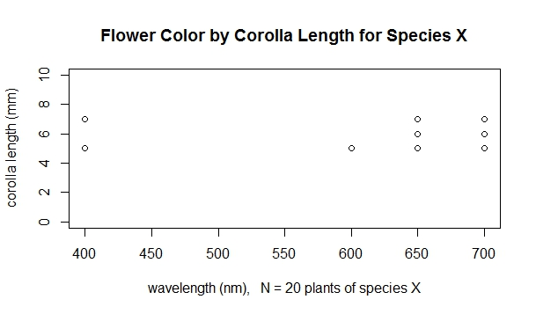
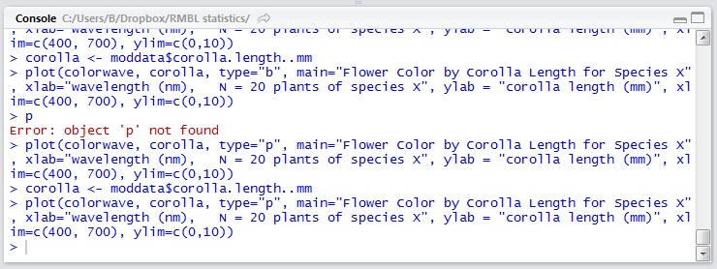
Module 2: Displaying Data
Notes:
Of course, you probably measured more than one numerical variable, and you want to see associations among them. In this case you would use a scatter plot which is the straightforward plot function. You first enter the data that you would like to plot in this case flower color (by wavelength) and corolla length. And then we specify how we want to display an association between them. Do we want to use points, lines or some other symbol? There is an official list of symbols for the plot function on the R documentation website. Most of you will use points or “p”. Then the familiar sequence of title, x and y axes labels. And then the ranges for the x and y axes.
A quick note on the x and y axes. You should try to display the data practically without distorting the data in anyway. So you usually start at zero. But in this case I started the x axis at 400. This corresponds to the red color spectrum. It doesn’t make biological sense to have a flower color in the 0 nm range which would be an x-ray. You can’t see x-rays.
I’ve only presented a handful of ways to display your data as these are the most often you encounter in the literature and you will most likely have to use a few of these plots for your data. But there are alternative ways such as using the map package in R or using the vcd package for categorical data. Quentin Read from Sanders Lab will present these alternative ways during his R graphing workshop.
Now that we have a visual sense of our data…it’s sometimes quite helpful to capture our data with a number or numerical summary. We will quickly go over the main numerical summaries for categorical and numerical data.

Slide 17
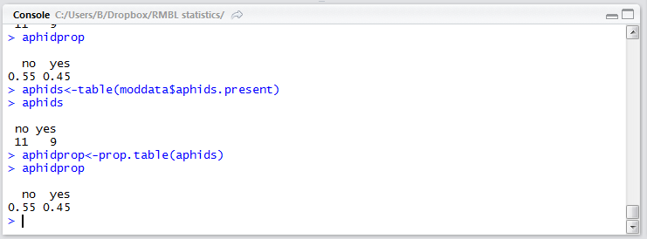
Module 2: Summarizing Data
Categorical: proportion or the number of observations for a particular category divided by the total number of observations
calculates proportions for observations by category

Slide 18
Module 2: Summarizing Data
Measures of center
mean and median
Numerical
Measures of spread
standard deviation and interquartile range
Notes:
For numerical data, we have more options as far as summarizing our data. When you think about numerical data, we often think about the data having a sense of mass, which leads us to think physically. This gives us measures of center and measures of spread. For measures of center, you already know mean and median while measures of spread are standard deviation and the interquartile range. R has functions for all these measures.
Let’s return to our flower color dataset and focus on flower color as measured by a spectrophotometer.

Slide 19
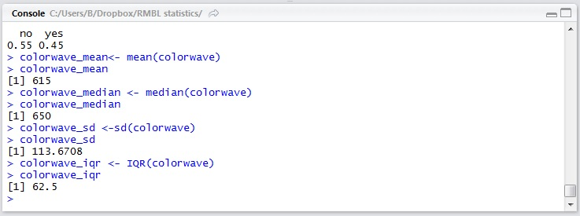
Module 2: Summarizing Data
mean
median
standard deviation
interquartile range
Notes:
Mean, median, standard deviation, and interquartile range are all functions in R.
Quick question: When should each measure be used? (ask class)…look at distribution. You have a clump of values toward the high end of the wavelength spectrum while you have a few measurements at the 400 nm end. The 400 nm end is pulling the measure of center towards it which gives you a hint that you should use the median over the mean. Likewise the standard deviation is being pulled similarly so the interquartile range would be a better descriptor of spread.
To get a sense of what the interquartile range looks like, we’ll quickly make a boxplot.

Slide 20
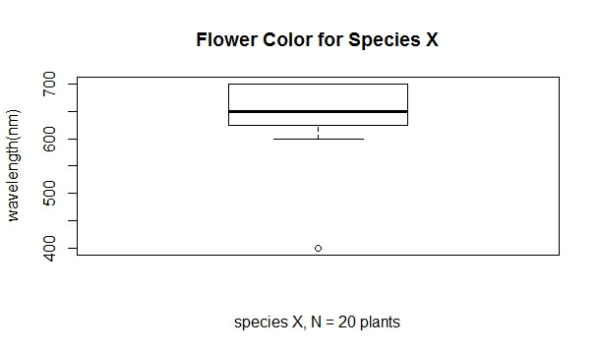
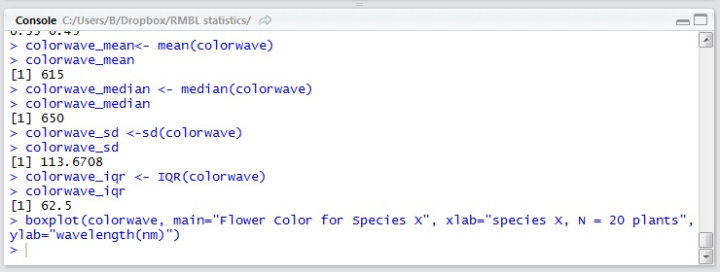
Module 2: Summarizing Data
interquartile range
outlier
Notes:
If you order all the data from smallest to largest, and then chop it up into four quarters or quartiles, you will be able to hand-calculate the interquartile range. The range itself is the first quartile to the third quartile and includes the median which is the second quartile. This allows us to identify outliers which are any value 1.5IQR outside the IQR itself.

Slide 21
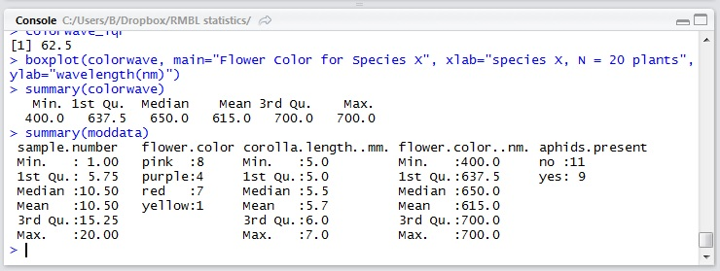
Module 2: Summarizing Data
summary() is a good way to quickly calculate measures of center, mean and median and the interquartile range
Notes:
Of course, you can easily compute some of the summary statistics using the summary function! You can summarize a vector or your entire dataset.

Slide 22
Module 2: R Observations
Note the pattern to each of these R methods: data, title, x and y-label axes, range limits, etc.
Notes:
Before we move forward, I just wanted to take a moment to notice a few patterns that will show up as you progress through your R computations. First, once you learn a method, in this case the plot method, there is a general pattern to how these methods work with R data types and objects. For example, you will always input the data first, then the plot title, then the x and y axes labels. All the plot methods regardless of what type of plot have this pattern. So when you learn a few plotting methods, you can easily apply them to novel plotting methods. Now you should have a sense of how to make a violin plot!
And remember the general pattern of defining a “dummy variable” so you can easily manipulate these objects and data types!
Picking up these types of patterns to the R methods that you will learn in the workshop will help you expand your knowledge of R beyond this workshop. Once you learn a few methods, you’ll be able to easily pick up other methods of the same type without necessarily having to practice them extensively.

Slide 23
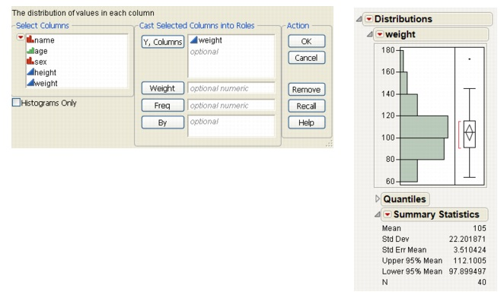
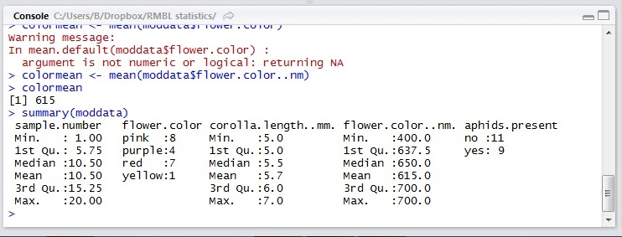
Module 2: R Observations
JMP interface
R console
Notes:
Another quick observation: You have already learned JMP, one statistical software package, and now you are learning (or reviewing) R. If you notice the statistics hasn’t changed, just the how you compute the statistics. JMP is much more point and click while in R you need to learn the methods and how to enter data types and objects. But the two packages are exactly the same in how you compute your statistics.
You are by no means married to any software package and you should feel free to experiment with as many packages as you like. Once you learn one software like R, it does make it easy to learn other similar software packages. And you can use different packages at different stages. For example, you can use R for all your plots while using JMP for your hypothesis testing. And you can use Excel to organize your data so you have minimal data manipulation in R or JMP. (and remember, don’t use Excel to run your hypothesis tests)!
And now we’ll break before we pick up in five minutes for hypothesis testing!

Slide 24
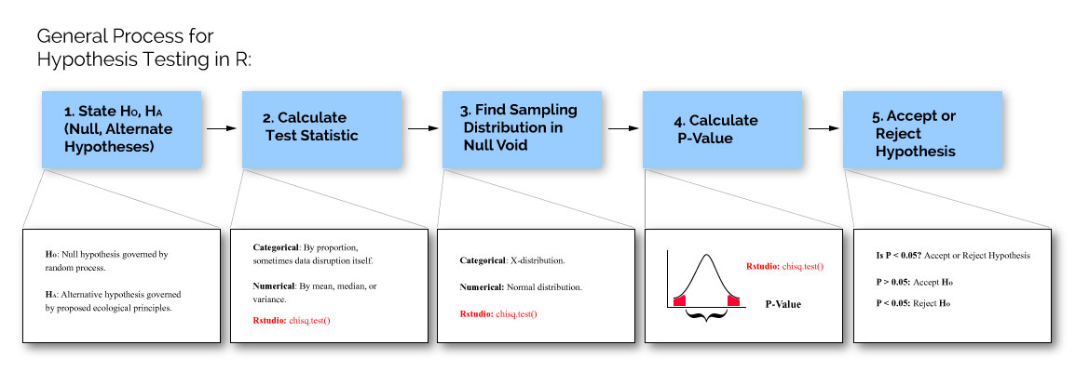
Module 3: Hypothesis Testing
Notes:
We just talked about patterns with R methods. Statistics has its’ own patterns within its methods, and before we jump into some of the most common statistical tests, let’s take a brief moment to talk about the general process for testing any hypothesis. You first need restate your null and alternative hypothesis. This is important since this will help you define how to calculate your p-values. Your null hypothesis will be governed by a random process while your alternative hypothesis will be governed by some ecological process (that you want to study).
Now you need to calculate a test statistic. This test statistic somehow summarizes your data succinctly, allowing for comparison with a null world dataset. This test statistic may be a summary statistic that we presented in Module 2 or it may take the summary statistics we computed in Module 2 to generate a new composite statistic (such as a ratio) that facilitates comparison to a null world.
Once you have this test statistic, we need to generate this null world. There are a multitude of mathematical descriptions that can describe a null world, each one suited to characterize your particular population. For example, if you are working with a categorical system, like sorting out flower color in a species, then you can use the chi-distribution which characterizes random assortment of samples into categories very well. Or if you are working with a large population and measuring flower color with a spectrophotometer…you might characterize your world as a normal distribution (the familiar bell curve).
Once you have selected your null distribution, you need to figure out the probability of obtaining the test statistic that you observed from your data in this null world. Basically, you’re trying to figure out can you get this result given a random world.
If the probability is very high, considered by convention in biology to be over 0.05, then you accept the null world, or more formally that you can obtain this result by chance. But if the probability is low, or less than 0.05, then there is a good chance that your ecological process may be governing the phenomenon you’re studying.
All the statistical tests that we will talk about in this workshop and the next follow this pattern. The tests are formulaic ways to test your hypotheses and they provide convenient algorithms or paths to determining whether you should accept or reject your hypothesis. In this workshop, you will learn how to use R to calculate test statistics, determine null distributions, and calculate P-values.

Slide 25
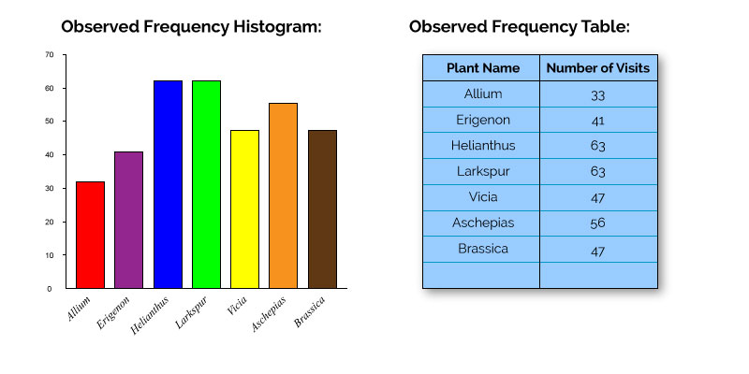
Module 3: Hypothesis Testing
Notes:
Let’s start out with an example of a classic categorical hypothesis test, the goodness-of-fit test. Sometimes when you’re observing how often a particular category pops up in your study population, you want to figure out how does what I’m observing varying from what I expect to observe. To be less vague, let’s run with an example. You are studying how often a particular species of bee visits flowers in an experimental meadow. You go out for a few weeks and observe how often your bee visits the flowers in the meadow.
Let’s say you decided to observe this bee because you wanted to determine whether your bee preferred a particular flower over any flower in the meadow. If the bee didn’t, then technically, the bee would visit each flower in the meadow based on how often it encountered the flower in the meadow (i.e. the bee’s visits would depend on the proportion of the flower species in the field). e.g. if the meadow were mostly Larkspur with some Alliums, then you would more likely see the bee visit Larkspur than Alliums just because it’s more likely to run into Larkspur. It would be interesting in this case if it turned out the bee visited Alliums over Larkspur…suggesting that there may be something biologically meaningful happening here.
To see if something biological meaningful is happening, you can use a goodness-of-fit test which uses the X distribution to assess the probability of obtaining your data.

Slide 26
Module 3: Hypothesis Testing
H0: The bee visits flowers with an equal frequency or proportion.
HA: The bee visits flowers unequally or some flowers more often than others.
Notes:
You state your hypothesis in terms of proportions.

Slide 27
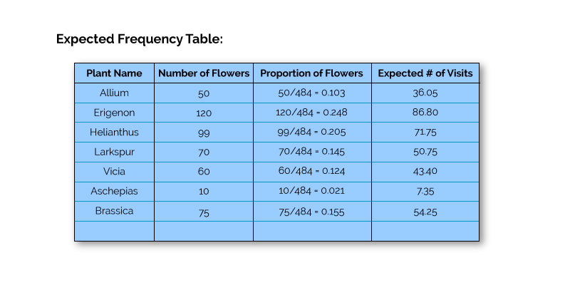
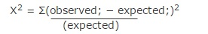
Module 3: Hypothesis Testing
Notes:
And you calculate your test statistic for your data. First you need to calculate what you expected to find. You calculate what should be the expected proportions based on how many flowers of a particular species are in a population. For example, there are a total of 50 Alliums in the total flower population of 484 flowers. The proportion of Alliums is just 50/484 or 0.103. If the bee makes a total of 350 visits, and 0.103 or 36.05 visits should be to Alliums.
Once you calculate the expected frequencies, you calculate the test statistic, in this case the X2 statistics which sums the difference between observed and expected as weighted by what you expected.

Slide 28
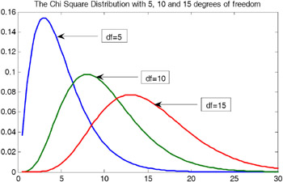
Module 3: Hypothesis Testing
Chi-distribution
degrees of freedom = n -1 or 6 for this case
Notes:
You will be calculating the probability of obtaining your statistic from the chi distribution, a common random proportional model. The chi distribution is actually a family of distributions, and you choose your chi distribution based on the degrees of freedom. Which is just 1 minus the category number or in our case 6 because we had seven different kinds of flowers

Slide 29
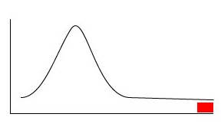
Module 3: Hypothesis Testing
The area under this curve or the probability that you can obtain a Χ² = 351.46 or greater is < 2.2*10⁻¹⁶
This is where the test statistics Χ² = 351.46
Notes:
You find on the chi distribution where the value is 351.46 or greater, and you calculate the area under the curve or the probability that you can obtain this test statistic or greater value…that’s the p-Value.
Do you accept or reject your H0? Is it a null world or better explained by something else?

Slide 30
Module 3: Hypothesis Testing
R computes
chisq.test(observed data, p = null.probabilities)
Notes:
Now, where does R come in all of this? Remember how tedious it was to calculate those values…this is what R does for you! R completes the middle steps for you to allow you to focus on the first and last steps.

Slide 31
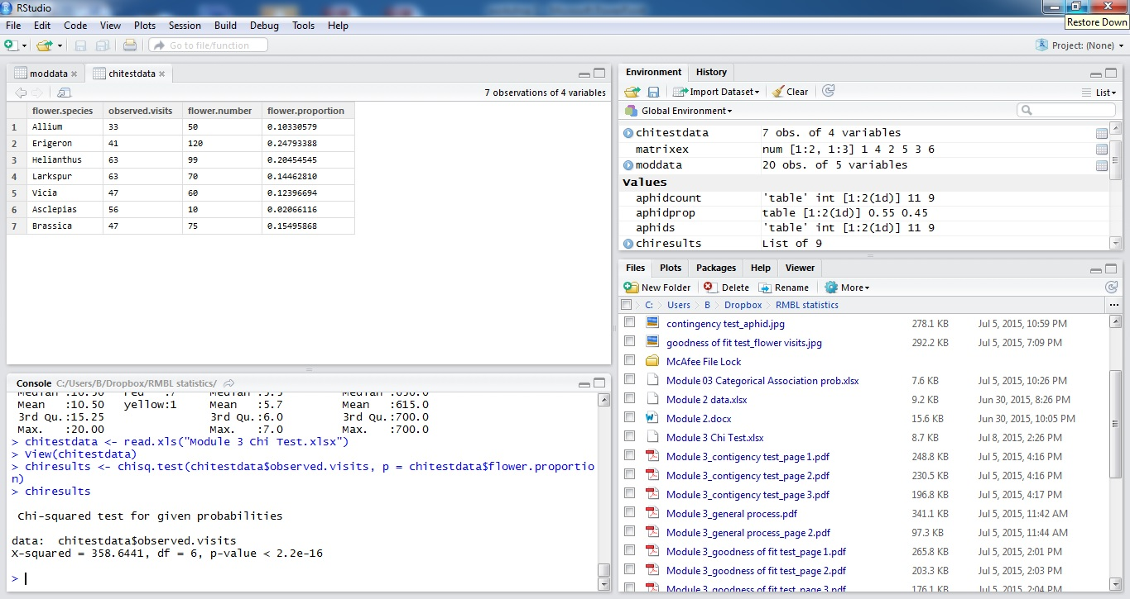
Module 3: Hypothesis Testing
Notes:
Here I ran the same data but in R. Let’s walk through the code quickly. First I imported the data, saved as a data frame with chitestdata. Then I viewed the data quickly so I could ensure that I wrote out the correct column names for the chi.sq test. Then I pulled the columns that I needed…the observed and the flower proportion for probabilities, and then used the chi.sq test…it conveniently does all the calculations we did by hand for us!
And you will report the test-statistics, df, and p-value

Slide 32
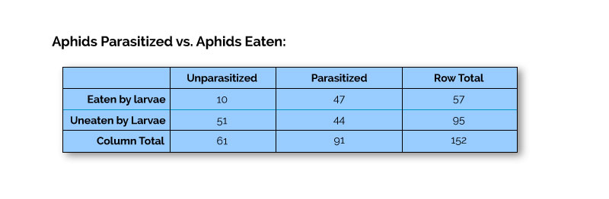
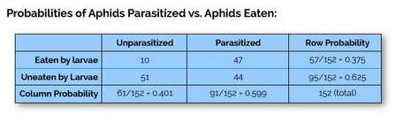
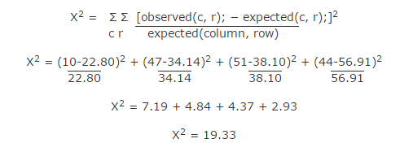
Module 3: Hypothesis Testing
Calculate expected values and test statistic X².
Then calculate the probability that you will obtain a X² = 19.33 from the chi-distribution with a df=1 (df = (r-1)(c-1)
Notes:
Chances are you probably measured more than one variable. And we can extend the goodness of fit test to learn whether there is an association among categorical variables. The calculations to find whether there is an association among two or more categorical variables is very similar to the calculations we just presented. Instead of thinking of a single vector of data, we will be thinking about a matrix of data. BUT the process to determine whether there is an association among two or more categorical variables still follows the same process as before!
Before we begin, we have to define what we mean by association. In this case, association among two variables means that the two variables are dependent on each other. If there is no association between the variables, we say they are independent. This is the association we will look to compute during our R computations.
Let’s begin with an example. Aphids are a big target in the insect world. Aphids can be parasitized by wasps which attack the aphids and turn them into mummies. Or they can be eaten by syrphid larvae, or the early stages of a pollinating fly. We want to see if you are more likely to be eaten by a syrphid larvae if you are already parasitized. We go out and count this phenomenon, and this is a summary of the data that we collected above.
Our H0 would be that syrphid larvae and parasitism are independent of each other. Our HA is that they are dependent.
Ok, let’s calculate the expected values. Before we begin, let’s remind ourselves of the law of independence. If two events are independent, then you just have to multiply their probabilities. We can calculate the individual probabilities from the table, and then we have to multiply that by the total sample (152). Then we stick that in the matrix formula for the chi statistic. Now we just have to turn to the chi distribution for the df =1.
Again, a lot of calculations! But now that you know what the test involves…let’s go through the R computation which returns us to our previous method: chisq.test

Slide 33
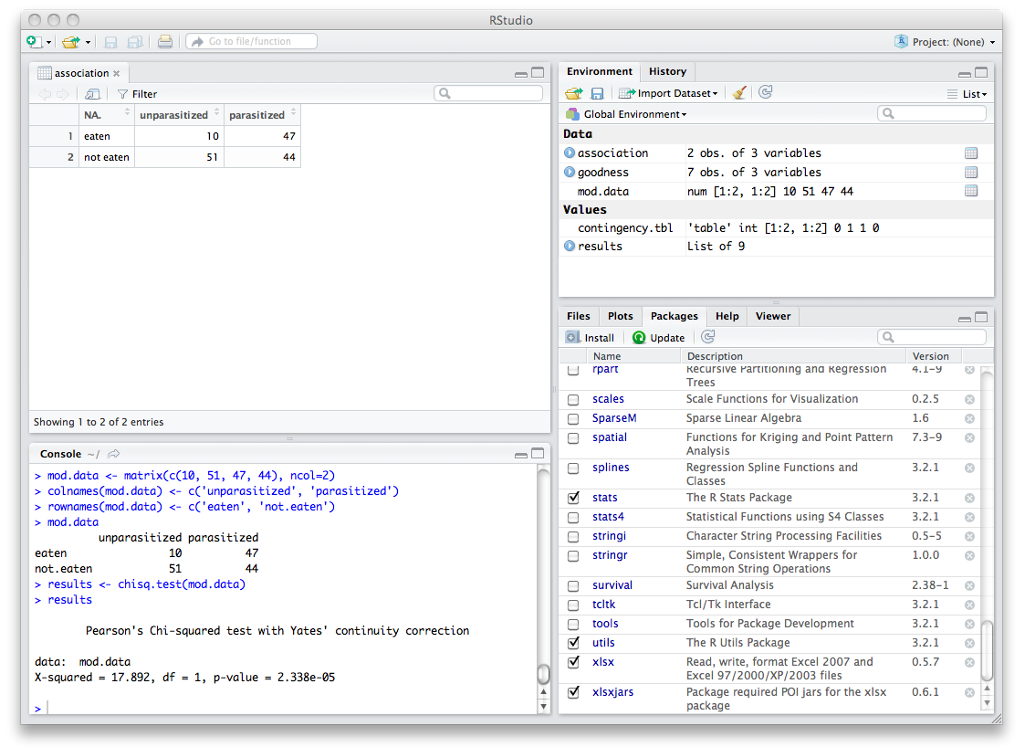
Module 3: Hypothesis Testing
chisq.test(matrix or table)
Notes:
Previously, you had to calculate the probabilities and use the p=null.probs. Why not here?

Slide 34
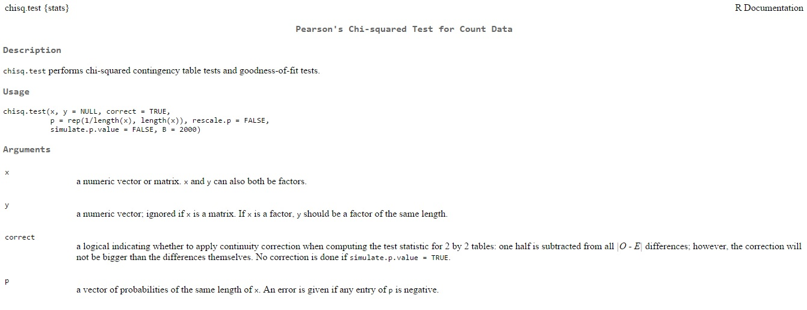
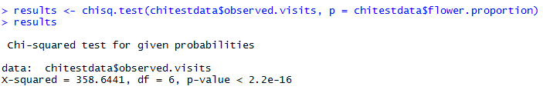
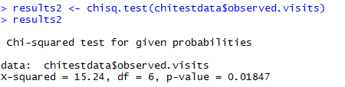
Module 3: Hypothesis Testing
Will calculate from your data unless your random probabilities depend on some factor not given in the table
Assuming that flowers have different abundances
Assuming that all flowers are equally abundant
Notes:
You needed to give the probabilities in the bee visitation example since you cannot obtain the number of occurrences without providing them. Without accounting for the actual abundances, you will have distorted results.
You don’t need to do this for the aphid-parasitoid-larvae matrix since you have the abundances in the table. R will compute this from the matrix itself. It has been written into the method.

Slide 35
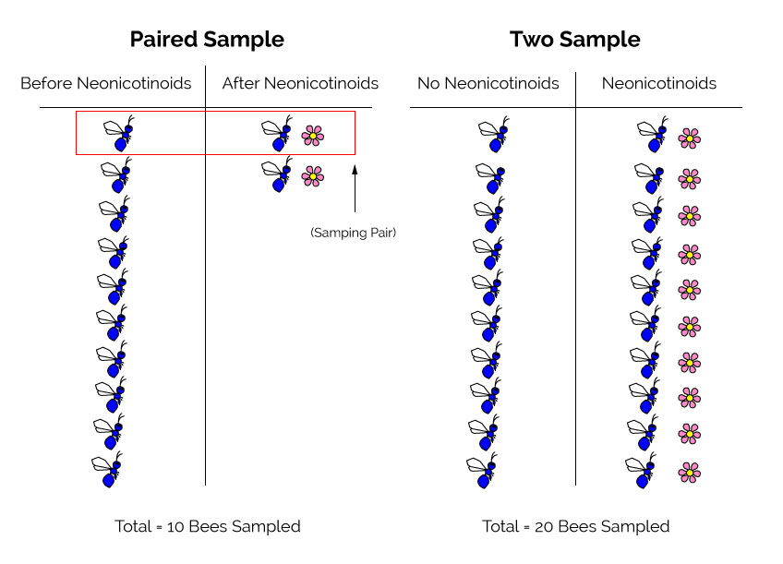
Module 3: Hypothesis Testing
Notes:
Ok, we’ve covered two common tests for understanding your categorical data…now we need to deal with your numerical data. Namely, if you measured a numerical response variable given a categorical explanatory variable. But before we go into the famous student t-test, we need to digress for a minute into a note about experimental design. There are two ways to measure a numerical variable given a two-treatment set-up: paired or unpaired (two sample). Depending on how you set up your experiment, you will run your t-test in R (and even if you hand calculated the data) slightly differently.
A paired sample is where you took a specimen and applied the same two treatments to the same specimen. A two sample setup is where you have different specimens for each treatment. Your test statistic t will change depending on whether you had a paired or unpaired sample.

Slide 36
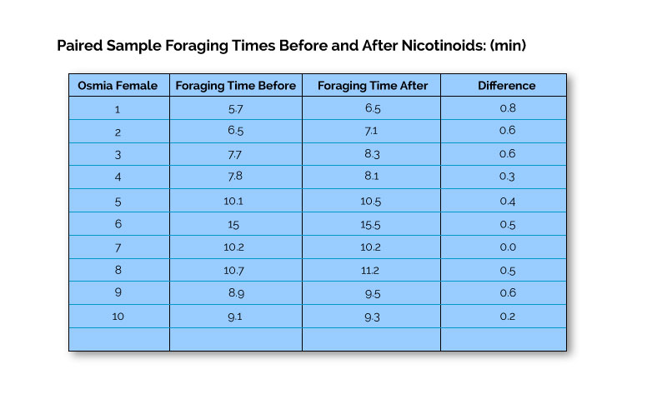
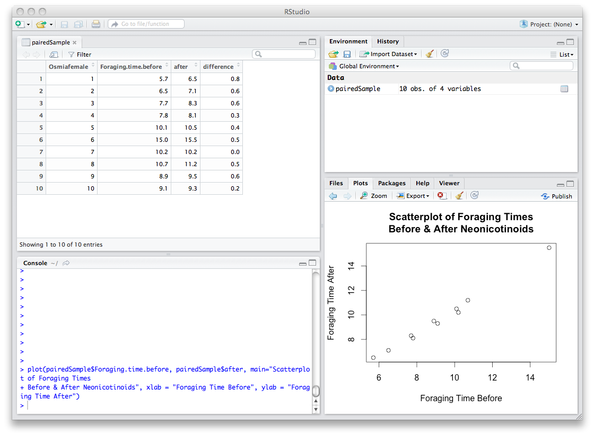
Module 3: Hypothesis Testing
Notes:
Notice trend in before and after

Slide 37
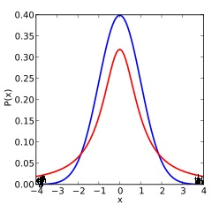

Module 3: Hypothesis Testing
Test statistic
t =
difference in means – expected difference
standard error of mean difference
Notes:
Let’s start out with the paired sample first. What’s your H0: difference is zero, HA: difference is not zero
T-statistic: difference in means between the before and after treatment
Use the t-distribution which is similar to the normal distribution, but fatter tails to account for sampling error
Then find the t-statistic on both ends, mean difference can go either way

Slide 38
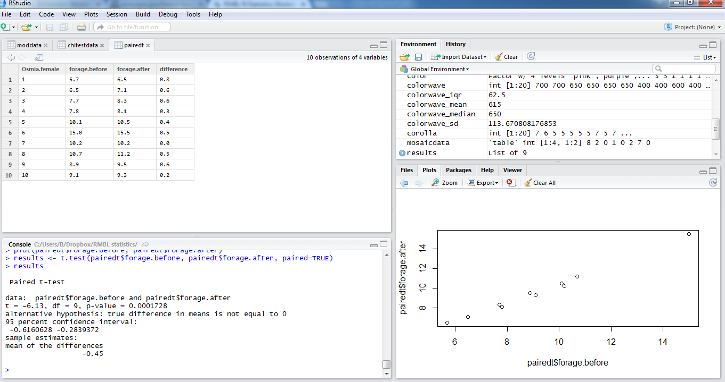
Module 3: Hypothesis Testing

Slide 39
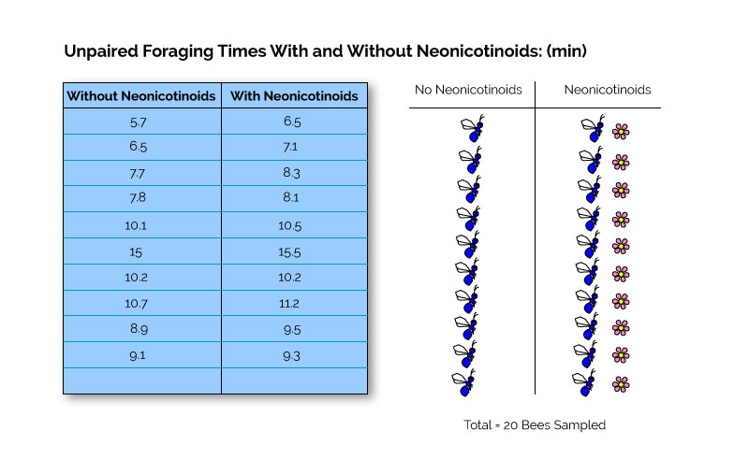
Module 3: Hypothesis Testing
Notes:
Now let’s do the same experiment but unpaired

Slide 40
Module 3: Hypothesis Testing
Test statistic
t =
treatment1_mean – treatment2_mean
standard error of mean difference
Notes:
We can think through this t-statistic a bit: What’s your H0: the means are equal, HA: the means are not equal
T-statistic: difference in means between two treatments/sampling error(accounts for mean1 minus mean2, basically accounts for variance in both treatment pools)
Then find the t-statistic on both ends, mean difference can go either way
And then follow same procedure

Slide 41
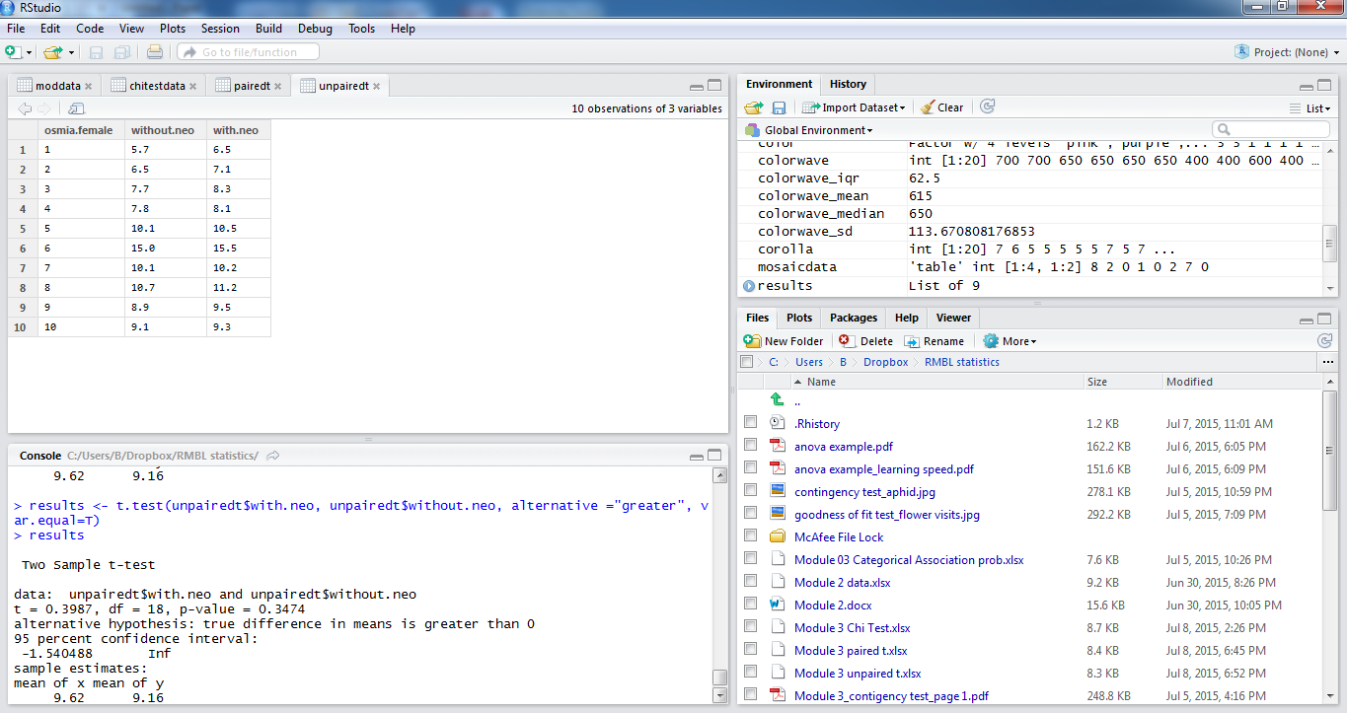
Module 3: Hypothesis Testing
Notes:
t.test(treatment1, treatment2, alternative = mean greater?, var.equal =T (are sample variances equal? We will assume yes otherwise Welch correction)…will talk about quality of data in next workshop

Slide 42
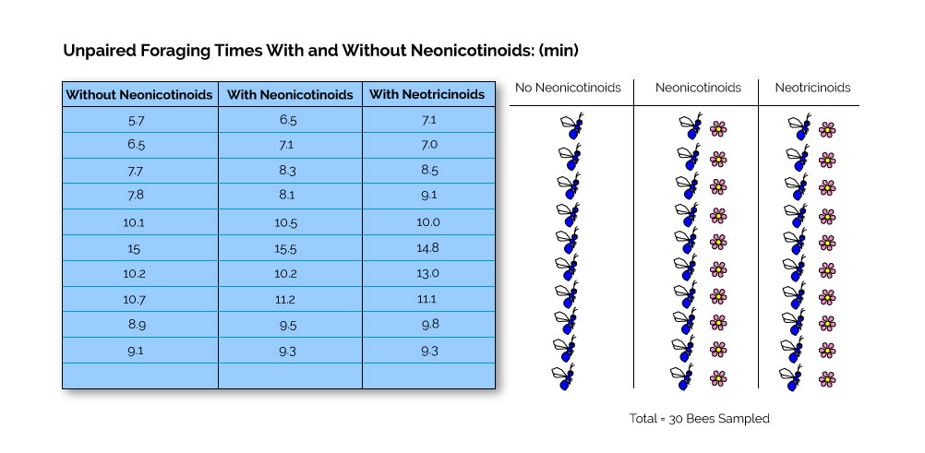
Module 3: Hypothesis Testing
Notes:
Ok, now we want to compare foraging among three treatments…we need to look at alternative methods…here we look at the variances…or testing for variation among groups…the ANOVA

Slide 43
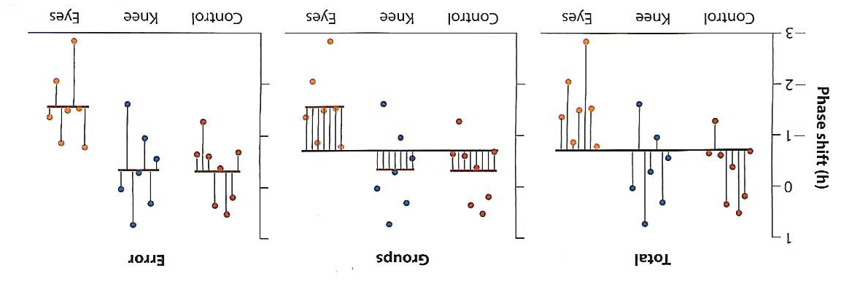
Module 3: Hypothesis Testing
no neo
neo
neotric
no neo
neo
neotric
no neo
neo
neotric
sum [sample variances of each group*(obs_group -1)]
group mean square
=
number of observations – number of groups
sum [number of obs in group*(group mean – grand mean]
error mean square
=
number of groups -1
group mean square
F
=
error mean square
Notes:
An ANOVA follows the same general process as before, but the calculations for the test statistics or the F-statistic can be quite long. Not because they are hairy, but because it’s a lot of arithmetic. For this last test presented today, we want you to get a sense of how we calculate the F-statistic and why we interpret the test in a certain way
First, let’s remind ourselves of what is the H0 and what’s the HA.
H0 is that all the means are equal. In our case that the means for foraging time for all three treatments are equal
HA: at least one mean is not equal
To test the null, an ANOVA breaks down two sources of variation:
The error (or residual) between every observation and the mean of its’ group
the deviation among the group means and the grand mean (of all observations)
The square of the error deviations is the error mean square OR a measure of the variability WITHIN groups
The group mean square represents the variation among individuals belonging to different groups.
These values should be equal if the treatments means are equal
If there is no difference among the means, then the F-statistic is close to 1. Otherwise if there is a difference among the means, then the F-statistic is greater than 1.
To calculate the P-value we need to use the F-distribution. It has a pair of dfs: one for the numerator and one for the denominator
the numerator has k-1 dfs (number of groups -1) and the denominator has N-k dfs (number of total obs – number of groups)

Slide 44
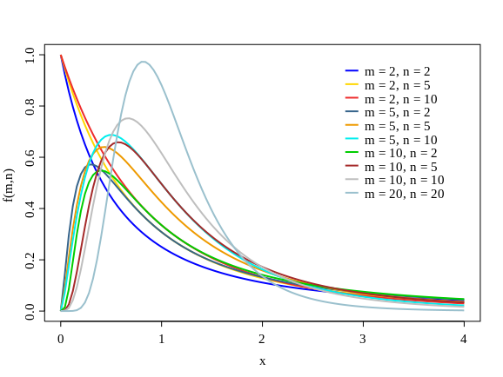
Module 3: Hypothesis Testing
Notes:
find F-statistic and calculate prob. there is a possibility that you can have f stats less than 1, but this would most likely occur by chance

Slide 45
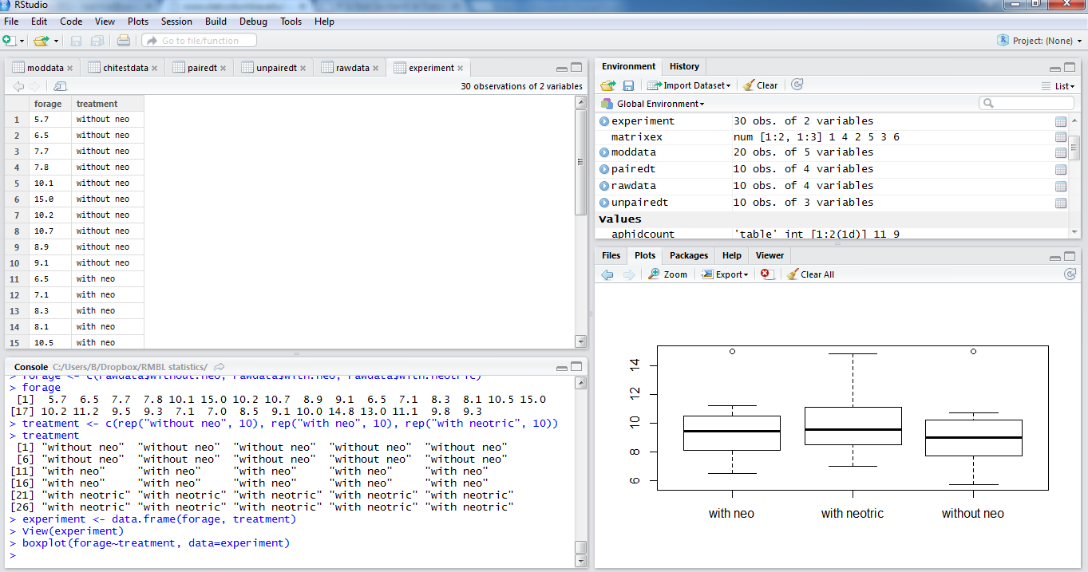
Module 3: Hypothesis Testing
Notes:
Let’s look at our data but first we need to do a little rearranging for the ANOVA.
We need to order our data in a more tabular form which we can do by concatenating our treatments together.
essentially you need to form one response variable column and one treatment variable column since this the heart of the test that you will run
I quickly viewed it as a boxplot to give you a sense of the data. Do you think the pesticide treatments will differ significantly?

Slide 46
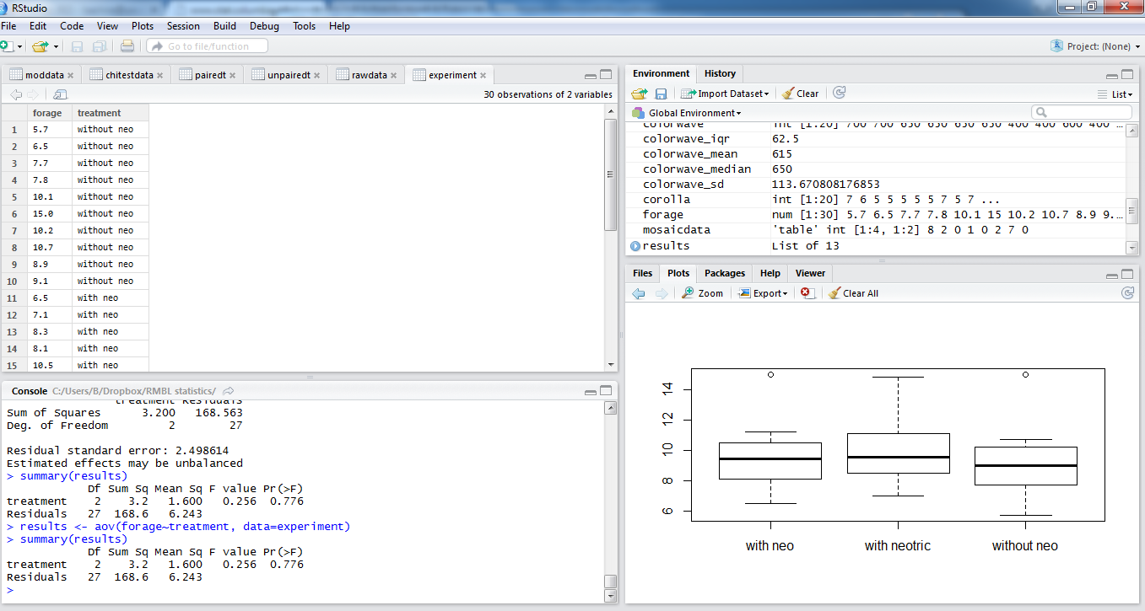
Module 3: Hypothesis Testing
Notes:
now we can run our ANOVA
which is simply results <- aov(response~treatment, data = data.frame)
and then a summary of results to give you the means and f statistic and p value
let’s go through the table

Slide 47
Example 1: Habitat selection by moose

Slide 48
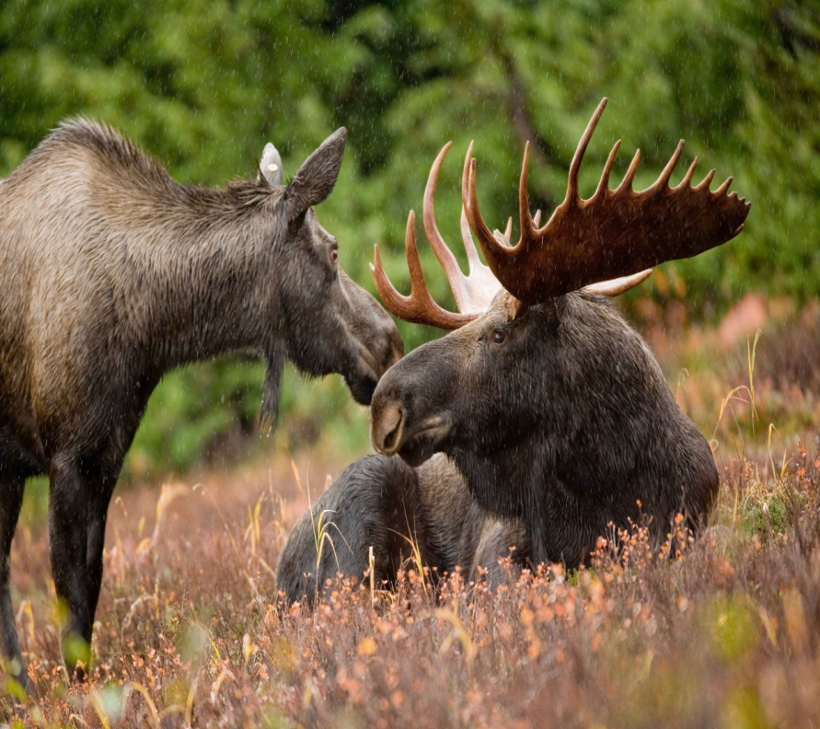
Question: do moose select a particular habitat type?
Define four habitat types
Count number of moose tracks
Calculate area of each habitat type
Calculate proportion of each habitat type
Notes:
In 1974, Neu et al. looked at habitat selection by moose (Alces alces) in and around the Little Sioux Burn area of Minnesota. The authors defined four types of habitat and measured their area: inside the burn area, the inside edge of the burn area, the outside edge of the burn area and outside of the burn area. They then went searching for moose tracks in the study area and assigned each track they found to one of those habitat types. This is the data they got.

Slide 49
The data
Habitat | Area (acres) | Number of moose | Proportion of area
Interior | 11283 | 25 | 0.340
Interior edge | 3345 | 22 | 0.101
Exterior edge | 3442 | 30 | 0.104
Exterior | 15130 | 40 | 0.455
Notes:
This is what the data they collected looks like.
1. If our question is “do moose select a particular habitat type” what are is our null hypothesis and our alternative hypothesis?
2. We have data on the distribution of moose tracks in different habitats, so you need to formulate your hypotheses based on that data.
3. Consider hypothesising about the probability of finding moose tracks in a particular habitat.

Slide 50
Hypotheses
Null Hypothesis
Alternative hypothesis
H₀: The probability of finding moose tracks in a particular habitat type is the same across all habitat types.
H_{A}: The probability of finding moose tracks in a particular habitat type is not the same across all habitat types.
Which test do we use?
Notes:
1. Now ask yourself, “Which test do we use to reject the null hypothesis or not?”
2. What information do you have? A: an observed freq. dist. and a theoretical freq. dist. (H0).
3. What do you want to do with those frequency distributions? A: compare them to see if the observed freq. dist. fits the theoretical freq. dist.
A: Chi-square goodness of fit.

Slide 51
Χ² Goodness of fit test
We have:
An observed frequency distribution
A hypothetical frequency distribution
Goal:
Compare the two with a Χ² goodness of fit test
R Code:
chisq.test(x, p = probs);
x is a numeric vector or matrix of the observed frequency distribution
probs is a vector of probabilities of the same length of x
Notes:
That’s the R code for a chi-square test.
x is your observed freq. dist. and p is the probabilities for each observation category.
Start R Studio, set your working directory (all data on the desktop folder ‘C:/Users/RMBL/Desktop/R Workshop 1 Data’).
Load the ‘xlsx’ library.
Load your data (moose_habitat_selection.xlsx) with the command read.xlsx
What columns correspond to x and p? A: x = Number.of.moose, p = Proportion.of.area.
Run the command.

Slide 52
R Code
## Set the working directory
setwd(“……");
## Load xlsx library
library("xlsx");
## Import dataset
moose <- read.xlsx("moose_habitat_selection.xlsx",1);
moose
## Chi-Square test
chisq.test(moose$Number.of.moose, p=moose$Proportion.of.area);

Slide 53
R Output & Meaning
Chi-squared test for given probabilities
data: moose$Number.of.moose
X-squared = 43.689, df = 3, p-value = 1.757e-09
If p < 0.05,
do we reject the H₀?
Do we have evidence to support H₁?
Notes:
R spits out a p-value far below 0.0001.
What does that mean: do we reject or accept the null hypothesis? A: reject H0.
Do we have evidence in support of the alternative hypothesis? A: yes.
What’s the answer to our question? A: Yes, moose do select a particular habitat type.

Slide 54
Example 2: Effects of a dam on sturgeon

Slide 55

Question: does a dam have an effect on sturgeon?
Dam built on the Saskatchewan River between The Pas and Cumberland House in Saskatchewan, Canada
Two sites:
The Pas
Cumberland House
Measure sturgeon characteristics:
Fork length
Weight
Age
Sex
Notes:
In the early 70’s a dam was built on the Saskatchewan River between the towns of The Pas and Cumberland House. The mighty sturgeon lives in this river and would migrate up and down it’s length. So, Dr. Antoine Morin asked if the dam had an impact on the sturgeon. To answer his question, he caught sturgeon above the dam at The Pas and below the dam at Cumberland. He measured various traits of the fish such as fork length, weight, age, sex, etc.

Slide 56
The data
sex | location | year | fklngth | wght | age
MALE | THE_PAS | 1978 | 37.00787 | 15.95 | 11
FEMALE | THE_PAS | 1978 | 50.19685 | NA | 24
MALE | THE_PAS | 1978 | 28.93701 | 6.49 | 7
FEMALE | THE_PAS | 1978 | 50.19685 | NA | 23
… | … | … | … | … | …
MALE | CUMBERLAND | 1978 | 44.01575 | 17.2 | 26
MALE | CUMBERLAND | 1978 | 37.00787 | 14 | 16
MALE | CUMBERLAND | 1978 | 39.17323 | 17.7 | 21
FEMALE | CUMBERLAND | 1978 | 46.85039 | 23.9 | 24
… | … | … | … | … | …
Notes:
This is what the data he collected looks like.
1. If our question is “does a dam have an effect on sturgeon” what are is our null hypothesis and our alternative hypothesis?
2. We have all sorts of data on sturgeon, but let’s focus on the fork length (a measure of size), so you need to formulate your hypotheses based on the fork length of the fish.
3. Consider hypothesising about the differences in the fork length at the two sites.

Slide 57
Hypotheses
Null Hypothesis
Alternative hypothesis
H₀: There is no difference in the mean fork length between the fish at either site.
H_{A}: There is a difference in the mean fork length between the fish at either site.
Which test do we use?
Notes:
Now ask yourself, “Which test do I use to reject the null hypothesis or not?”
What information do you have? A: lots of measurements of fork length for fish a two sites.
What do we want to do with that information? A: compare the averages between sites.
A: Student’s T-test

Slide 58
Student’s T-test
We have:
Measurements of fork length
Measurements from fish of two different sites
Goal:
Compare means to see if there are statistically significant differences between sites.
R Code:
t.test(depVar ~ indepVar)
depVar is the numeric dependent variable
indepVar is the categorical independent variable
Notes:
That’s the R code for an Student’s T-test.
depVar is the numeric dependent variable and indepVar is the categorical independent variable.
Start R Studio, set your working directory (all data on the desktop folder ‘C:/Users/RMBL/Desktop/R Workshop 1 Data’).
Load the ‘xlsx’ library.
Load your data (sturgeon.xlsx) with the command read.xlsx
What data corresponds to depVar and indepVar? A: depVar = fklngth, indepVar = location
Run the command.

Slide 59
R Code
## Set the working directory
setwd(“……");
## Load xlsx library
library("xlsx");
## Import dataset
sturgeon <- read.xlsx("sturgeon.xlsx",1);
sturgeon
## Student t-test
t.test(sturgeon$fklngth ~ sturgeon$location);

Slide 60
R Output & Meaning
Welch Two Sample t-test
data: sturgeon$fklngth by sturgeon$location
t = 2.2201, df = 169.8, p-value = 0.02774
alternative hypothesis: true difference in means is not equal to 0
95 percent confidence interval:
0.1900117 3.2390804
sample estimates:
mean in group CUMBERLAND mean in group THE_PAS
45.08439 43.36984
If p < 0.05, do we reject the H₀ or Do we have evidence to support H₁?
Notes:
R spits out a p-value below 0.05.
What does that mean: do we reject or accept the null hypothesis? A: reject H0.
Do we have evidence in support of the alternative hypothesis? A: yes.
What’s the answer to our question? A: Yes, the dam is having an effect on the sturgeon.

Slide 61
95% CI for the means
## 95% CI for THE_PAS mean
sturgeon.THE_PAS = sturgeon$location == "THE_PAS";
sturgeon.THE_PAS = sturgeon[sturgeon.THE_PAS,]$fklngth;
t.test(sturgeon.THE_PAS)
## 95% CI for CUMBERLAND mean
sturgeon.CUMBERLAND = sturgeon$location == "CUMBERLAND";
sturgeon.CUMBERLAND = sturgeon[sturgeon.CUMBERLAND,]$fklngth;
t.test(sturgeon.CUMBERLAND)
Notes:
Note that when reporting the results of a t-test, we should always state the means of the groups and the 95% CI for the groups. This is the code needed to accomplish that.

Slide 62
Example 3: Effect of riparian vegetation restoration on bird communities.

Slide 63

Question: does restoring riparian vegetation modify the bird community?
Census of bird species in remnant (degraded) and restored riparian habitat along Californian rivers
Habitat types:
Remnant (degraded)
Restored
Species present:
Oak Titmouse
Bushtit
Bewick's Wren
House Wren
Spotted Towhee
Song Sparrow
House Finch
Lesser Goldfinch
American Goldfinch
Ruby-crowned Kinglet
Hermit Thrush
Orange-crowned Warbler
Yellow-rumped Warbler
Savannah Sparrow
Fox Sparrow
Lincoln's Sparrow
White-crowned Sparrow
Golden-crowned Sparrow
Dark-eyed Junco
Notes:
In theory, restoring riparian vegetation is an easy and inexpensive way of generating habitat for many species of birds. However, we should test this theory out by asking, “Does resorting riparian vegetation modify the bird community?” Latta and colleagues did just that by performing a census of the bird populations at various riparian habitats along Californian Rivers. They counted the number of birds of different species at remnant or degraded habitat and restored habitats.

Slide 64
The data
Species | Remnant | Restored
Oak Titmouse | 19 | 9
Bushtit | 198 | 91
Bewick's Wren | 106 | 48
House Wren | 44 | 10
Spotted Towhee | 137 | 32
Song Sparrow | 150 | 50
House Finch | 26 | 0
Lesser Goldfinch | 57 | 15
American Goldfinch | 12 | 10
… | … | …
Notes:
This is what their data looks like.
1. If our question is “does restoring riparian vegetation modify the bird community” what are is our null hypothesis and our alternative hypothesis?
2. We have data on habitat type and on species, so you need to formulate your hypotheses based on habitat type and species.
3. Consider hypothesising about the differences in species composition across habitat types.

Slide 65
Hypotheses
Null Hypothesis
Alternative hypothesis
H₀: Species present in a location is independent of habitat type.
H_{A}: Species present in a location is dependent on the habitat type.
Which test do we use?
Notes:
Now ask yourself, “Which test do I use to reject the null hypothesis or not?”
What information do you have and what kind of information is it? A: habitat type (categorical) and species (categorical).
What do we want to do with that information? A: check if they are related to each other or independent of each other.
A: Chi-square test of independence.

Slide 66
Χ² Test of independence
We have:
Habitat type (categorical)
Species present (categorical)
Goal:
Test if species is independent of habitat type
R Code:
chisq.test(x);
x is a numeric matrix of the observed frequency distribution
Note: you must setup your data with proper row names
newData <- data[,-1]
rownames(newData) <- data[,1]
Notes:
That’s the R code for a Chi-square test of independence.
X is a numeric matrix of the observed freq. dist.
Start R Studio, set your working directory (all data on the desktop folder ‘C:/Users/RMBL/Desktop/R Workshop 1 Data’).
Load the ‘xlsx’ library.
Load your data (restored_riparian_birds.xlsx) with the command read.xlsx
Before inputing the data into the chisq.test function, we need to modify it by providing row names using the following code.
Run the command.

Slide 67
R Code
## Set the working directory
setwd(“……");
## Load xlsx library
library("xlsx");
## Import dataset
data <- read.xlsx("restored_riparian_birds.xlsx",1);
birds <- data[,-1]
rownames(birds) <- data[,1]
## Chi-Square test of independence (contingency test)
chisq.test(birds);

Slide 68
R Output & Meaning
Pearson's Chi-squared test
data: birds
X-squared = 179.39, df = 18, p-value < 2.2e-16
If p < 0.05,
do we reject the H₀?
Do we have evidence to support H₁?
Notes:
R spits out a p-value far less than 0.0001.
What does that mean: do we reject or accept the null hypothesis? A: reject H0.
Do we have evidence in support of the alternative hypothesis? A: yes.
What’s the answer to our question? A: Yes, restoring riparian vegetation does affect the bird community.

Slide 69
Example 4: Effect of neonicotinoid pesticides on bumblebee colony queen production

Slide 70
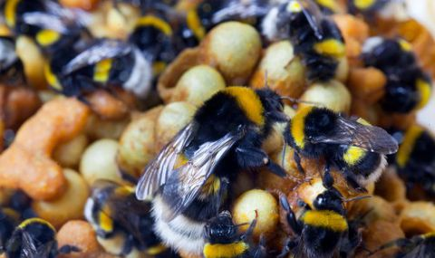
Question: are pesticides harmful to bees?
Rear Bombus terrestris colonies in the lab
Three treatments:
Control
Low pesticide exposure
High pesticide exposure
Measure colony characteristics:
Colony mass through time
# of workers left at end
# of males & queens produced
Etc…
Notes:
We hear a lot on the news about pesticides being harmful to bees. Well, as good scientists let’s test that idea out! Whitehorn and colleagues took a bunch of bumblebee colonies and assigned them to one of three treatments: a low exposure to pesticides, a high exposure to pesticides and a control (no exposure). They then measured various characteristics of the colonies such as colony mass through time, # of workers at the end of the experiment, # of males and queens produced and other characteristics.

Slide 71
The data
Treatment | Nest ID | Mass (g) | New queens
Control | C1 | 712.95 | 1
Control | C2 | 719.58 | 0
... | ... | ... | ...
Low | L1 | 701.34 | 0
Low | L2 | 735.36 | 0
... | ... | ... | ...
High | H1 | 706.36 | 8
High | H2 | 710.48 | 0
… | ... | ... | ...
Notes:
This is what the data they collected looks like. I’ve omitted a bunch of traits for clarity.
1. If our question is “are pesticides harmful to bees” what are our null hypothesis and our alternative hypothesis?
2. We have all sorts of data on the colonies, but let’s focus on the number of queens produced, so you need to formulate your hypotheses based on the number of queens produced.
3. Consider hypothesising about the differences in the number of queens produced.

Slide 72
Hypotheses
Null Hypothesis
Alternative hypothesis
H₀: There is no difference in the number of queens produced between the three treatments.
H_{A}: There is at least one difference in the number of queens produced between the three treatments.
Which test do we use?
Notes:
Now ask yourself, “Which test do I use to reject the null hypothesis or not?”
What information do you have and what kind of information is it? A: number of queens produced averaged for each treatment.
What do we want to do with that information? A: compare to see if there are statistically significant differences.
A: Analysis of variance (ANOVA)

Slide 73
Analysis of Variance (ANOVA)
We have:
Average number of queens produced per treatment
Three treatments
Goal:
Compare averages to see if there are statistically significant differences between treatments.
R Code:
my.anova <- aov(depVar ~ indepVar);
summary(my.anova);
my.anova is a variable that will hold the model
depVar is the numeric dependent variable
indepVar is the categorical independent variable
Notes:
That’s the R code for an ANOVA
depVar is the numeric dependent variable and indepVar is the categorical independent variable.
Start R Studio, set your working directory (all data on the desktop folder ‘C:/Users/RMBL/Desktop/R Workshop 1 Data’).
Load the ‘xlsx’ library.
Load your data (pesticide_effects_on_bumblebees.xlsx) with the command read.xlsx
What data corresponds to depVar and indepVar? A: depVar = New.queens, indepVar = Treatment.
Run the command.

Slide 74
R Code
## Set the working directory
setwd(“……");
## Load xlsx library
library("xlsx");
## Import dataset
bumblebees <- read.xlsx("pesticide_effects_on_bumblebees.xlsx",1);
bumblebees
## Analysis of Variance
bumblebees.test <- aov(bumblebees$New.queens ~ bumblebees$Treatment);
summary(bumblebees.test)

Slide 75
R Output & Meaning
Df Sum Sq Mean Sq F value Pr(>F)
bumblebees$Treatment 2 2413 1206.3 4.255 0.0179 *
Residuals 72 20413 283.5
If p < 0.05,
do we reject the H₀?
Do we have evidence to support H₁?
Notes:
R spits out a p-value < 0.05.
What does that mean: do we reject or accept the null hypothesis? A: reject H0.
Do we have evidence in support of the alternative hypothesis? A: yes.
What’s the answer to our question? A: Yes, pesticides are having an effect on bees.

Slide 76
RMBL R Workshop 2
Module 5: ANOVAs and Assumption Violations
Module 6: Correlations
Module 7: Regressions
Module 8: Examples of Four Hypothesis Tests
Module 9: Introduction to Bayesian Statistics including
Phylogenetic and Morphometric Applications

